Slide 1



“What is your Metaverse Strategy? And Why Every Brand Needs One…”

Slide 2
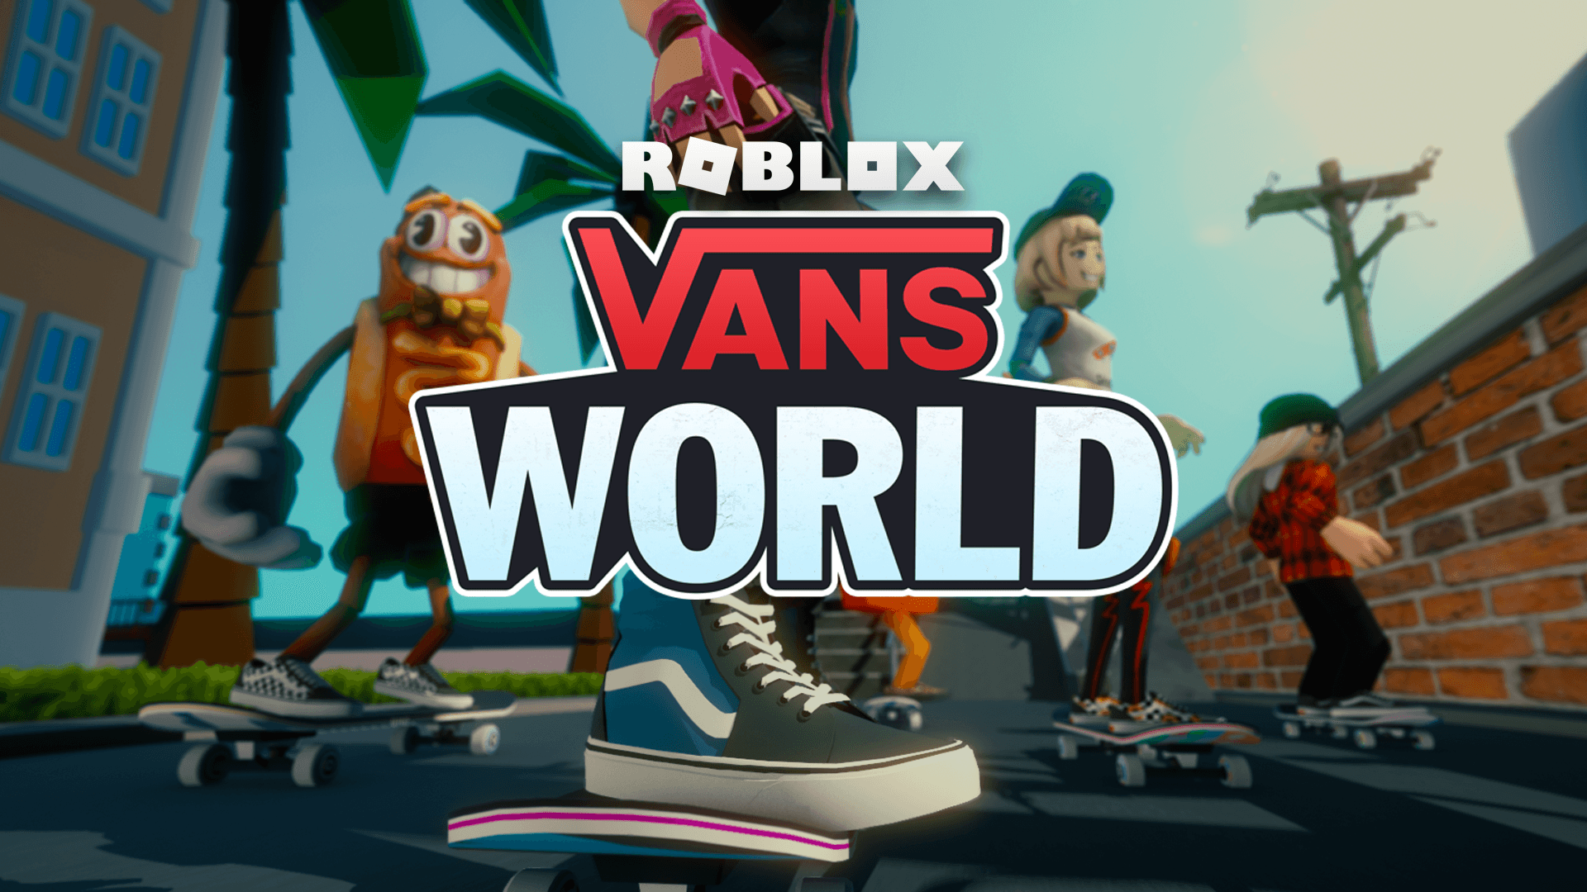

Slide 3
Key Takeaways
It’s increasingly important for brands to have a Metaverse strategy to continue staying relevant, connect with fans globally, and create new revenue streams.
Be thoughtful on how to authentically enter the Metaverse, and work with the community/think of the users to elevate their experience.
Personal self-expression and identity in the Metaverse is paramount and drives genuine creativity on the platforms. Digital product, thus becomes fundamental to that expression, and a vital opportunity for brands to establish more meaningful connections with their fans.
Persistent brand presence in the Metaverse can help bridge the gap between virtual and real-world fashion in an accessible, sustainable and inclusive way.

